Slide 1
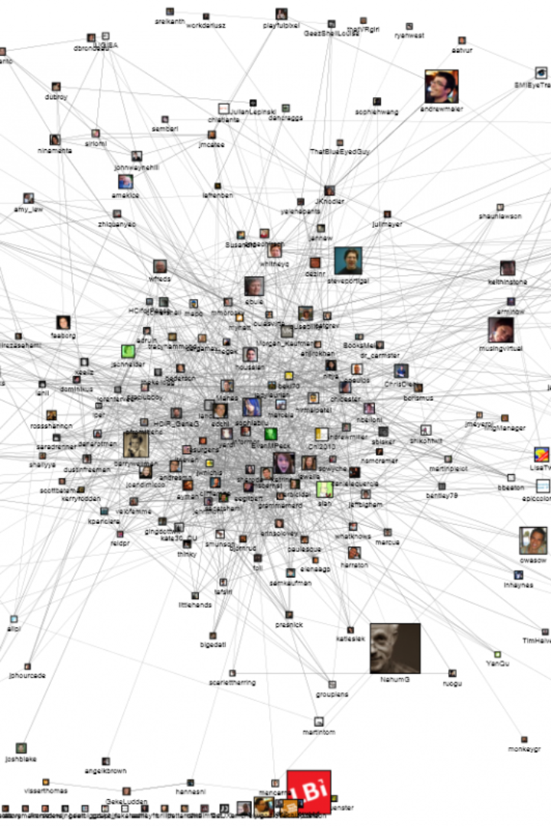
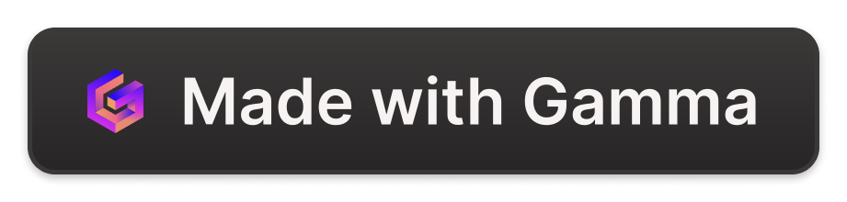
Introduction to Web Scraping for Social Sciences
Welcome to a comprehensive journey into the world of web scraping, an invaluable skill for social science researchers. As we delve into this digital technique, you'll learn how to transform the vast sea of online information into actionable, insightful data for your research projects. From understanding the basics to mastering ethical and legal practices, this presentation is designed to equip you with the tools and knowledge necessary to harness the power of web scraping in the context of social sciences.
This session is led by an experienced instructor who'll guide you through the intricacies of digital data collection and provide you with the best practices to apply this skill effectively in your own research endeavors. Get ready to explore the limitless potential of web scraping.
Contact information for further queries and in-depth discussions will be provided at the conclusion of the session.
hh
by Ma Ming

Slide 2
What is Web Scraping?
Detailed Definition
Traditional Data Collection
Web scraping, at its core, is the automated process of extracting large amounts of data from websites. It involves programmatically navigating web pages and collecting required data elements from the HTML structure. Also known as web harvesting or web data extraction, this technique makes it possible to quickly gather information that would be time-consuming to compile manually.
Unlike traditional data collection methods that often involve manual surveying or curation of information, web scraping thrives on its ability to process vast amounts of data expeditiously. It offers unprecedented speed, remarkable efficiency, and the scale necessary to sift through today's big data landscapes, making it a vital skill for the modern researcher.

Slide 3
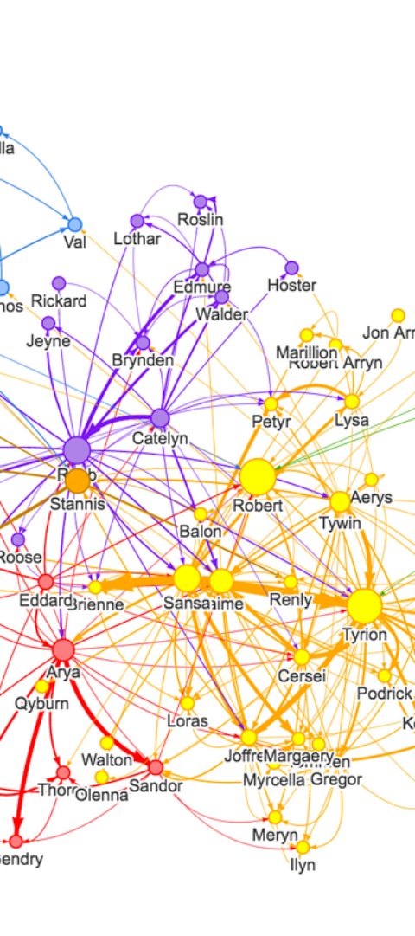
Relevance to Social Sciences
1
Election Trend Analysis
In the sphere of political science, web scraping can be used to analyze election trends by gathering real-time data from news outlets, social media, and polling results. This provides researchers with a dynamic perspective of political shifts and public sentiment.
2
Social Media Sentiment Analysis
By extracting data from social platforms, researchers can conduct sentiment analysis to understand public emotions and opinions on various social issues. This can shed light on societal trends and enable more effective policy-making.
3
Demographic Data Collection
Demographic data is crucial for understanding social structures and behaviors. Web scraping simplifies the collection of such data from diverse online sources, providing deeper insight into different population segments.

Slide 4
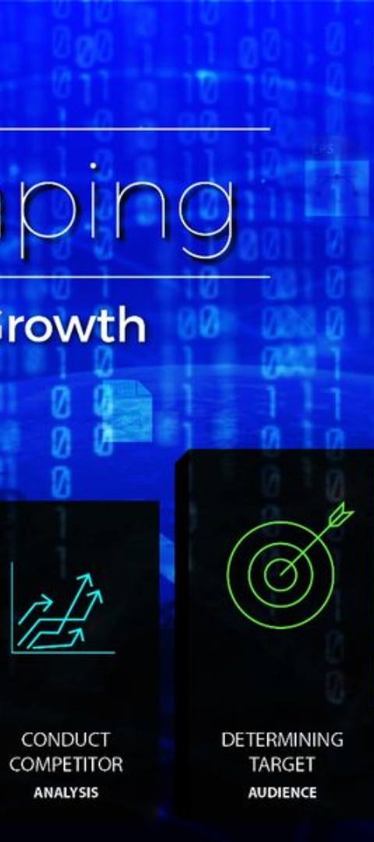
Ethical Considerations
User Privacy
The essence of ethical web scraping lies in respecting user privacy. Researchers must ensure that they avoid personal data unless it is essential and consent has been obtained. Anonymizing data wherever possible is a step towards maintaining privacy standards.
Sensitive Data
Avoiding sensitive data is a critical ethical principle. Researchers should steer clear of information that can cause harm or distress if disclosed or misused. Ethical scraping practices prioritize the wellbeing of data subjects.
Data Transparency
Researchers must be transparent about how they intend to use the data collected through web scraping. This includes clear communication about the purpose of the research and measures taken to protect the data's integrity.

Slide 5
Legal Aspects
Legal Framework Overview
Terms of Service Compliance
Web scraping operates within a complex legal framework, influenced by legislation such as the General Data Protection Regulation (GDPR) and the Computer Fraud and Abuse Act. Understanding the nuances of these laws is paramount in conducting legal web scraping activities.
It's crucial for researchers to adhere to the terms of service of the websites they scrape. Violating these can lead to legal repercussions and undermine the credibility of the research.

Slide 6

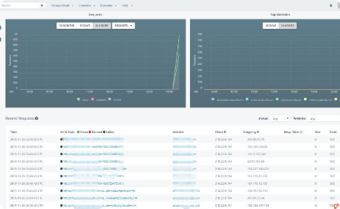
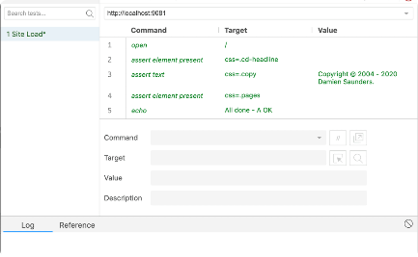
Tools for Web Scraping
Beautiful Soup
Scrapy
Selenium
An easy-to-use Python library designed for rapid turnaround projects. It provides simple methods for navigating, searching, and modifying the parse tree of HTML or XML documents.
A powerful web crawling framework for Python, suited for large-scale data extraction. It provides robust handling of requests and can be integrated with a database system for automated data storage.
Primarily used for automating web applications for testing purposes, Selenium can also be exploited for web scraping, especially when dealing with sites that have dynamic content loaded with JavaScript.

Slide 7
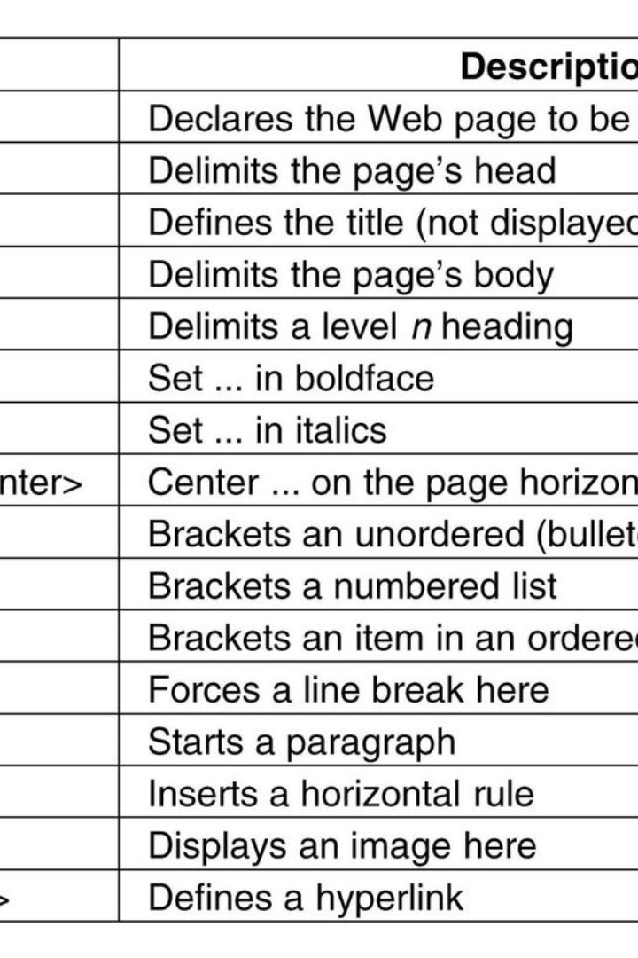
Understanding HTML and CSS
At the heart of web scraping is a fundamental understanding of HTML and CSS, the building blocks of web pages. HTML provides the structure, using elements represented by tags such as div, span, a, and p. Each element can have attributes like classes and IDs to identify and select them with greater specificity when scraping.
CSS, on the other hand, styles these elements. Scraping tools often use CSS selectors to navigate through elements, uncovering the data that resides within the HTML architecture.

Slide 8
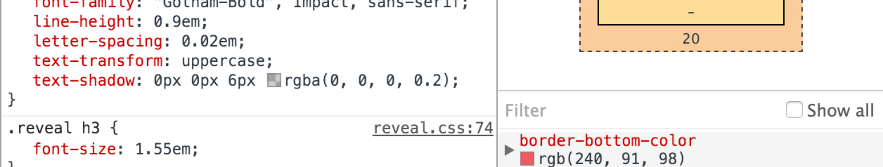
Finding the Data
1
Browser Tools
2
Data Point Identification
The journey to finding the data starts with the browser's developer tools. Here, researchers can inspect the HTML structure of any webpage, revealing the tags that house the desired data points.
Discovering which data points to extract is an art. Look for patterns in the HTML that can be consistently applied to scrape the necessary information without capturing unnecessary noise.

Slide 9
Python for Web Scraping
Why Python?
Python is a favorite in the scraping community due to its easy-to-read syntax, robust libraries, and broad support within the data science community. For web scraping, in particular, it offers a variety of libraries and tools that automate and facilitate the extraction process.
Libraries play a significant role in Python's scraping capabilities. With options like Requests, to handle HTTP requests, and LXML, to parse HTML/XML documents, the language provides a powerful, high-level interface for web scraping.

Slide 10
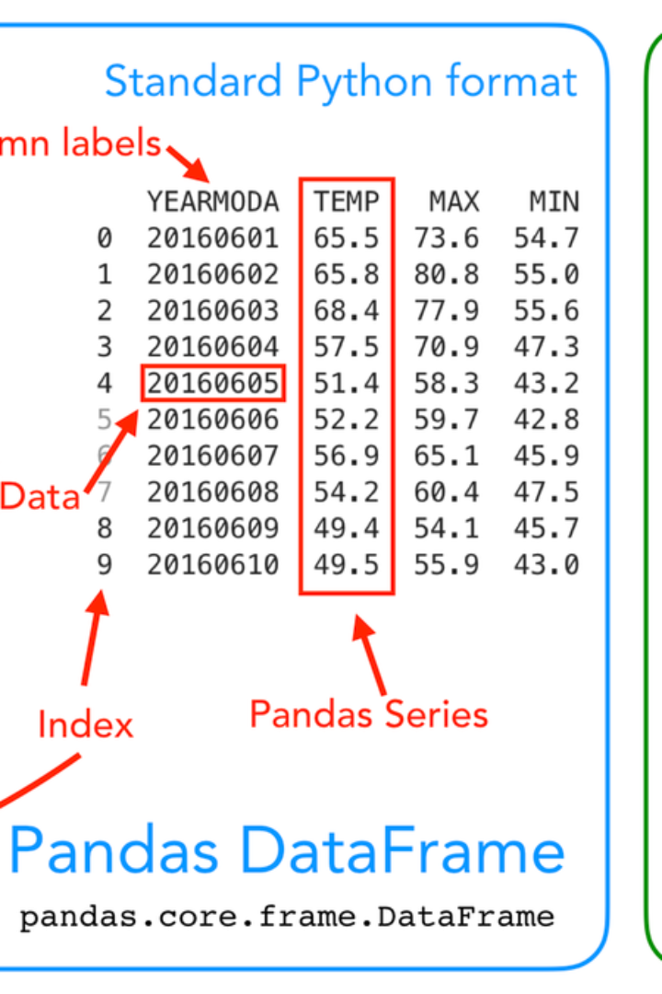
Basic Python Scripting
Script Example
A basic Python script to scrape and print webpage content typically involves importing the necessary libraries, sending a request to the webpage, parsing the HTML content, and finally, extracting and printing the desired data.
Explaining each step in the script helps to conceptualize how Python executes the scraping task, and showcases how a few lines of code can powerfully gather information from the web.

Slide 11
Data Extraction Techniques
Text Extraction
Gathering raw text from HTML elements.
Image Scraping
Downloading images by accessing image tags and their source attributes.
Link Collection
Compiling a list of hyperlinks by targeting anchor tags.
Handling HTML
Dealing with a site's markup to locate data.
Handling JSON
Parsing JSON objects returned from APIs or configurations.
Handling XML
Working with XML feeds or sitemaps.

Slide 12
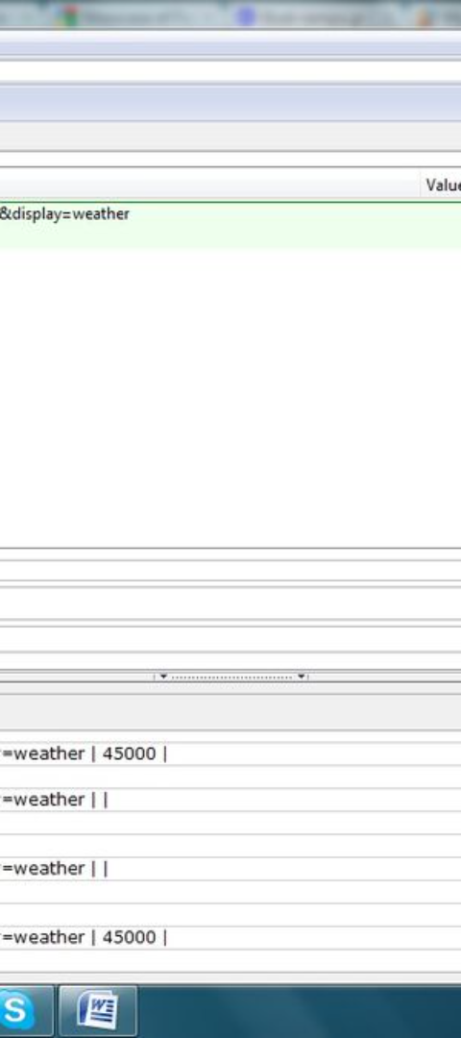


Handling Dynamic Webpages
Static vs Dynamic
Understanding the difference between static and dynamic web content is key to handling variable webpages. Static pages are easier to scrape because the content doesn't change with user interaction, whereas dynamic pages require more sophisticated methods to access their data.
Selenium Automation
Selenium bridges the gap in scraping dynamic content. It simulates user interactions, allowing the retrieval of content that is loaded asynchronously or through JavaScript events after the initial page load.

Slide 13
Data Storage
Storage Mechanisms
Data Format Decisions
Choosing the right storage mechanism can vastly affect the usability and performance of the scraped data. CSV files are an excellent choice for simple tabular data, while databases like SQL are suited for larger, more complex datasets.
Deciding on a data format is crucial and depends on the type of data and its intended use. CSV is straightforward for flat data, whereas databases offer robust querying capabilities for more sophisticated analysis.

Slide 14
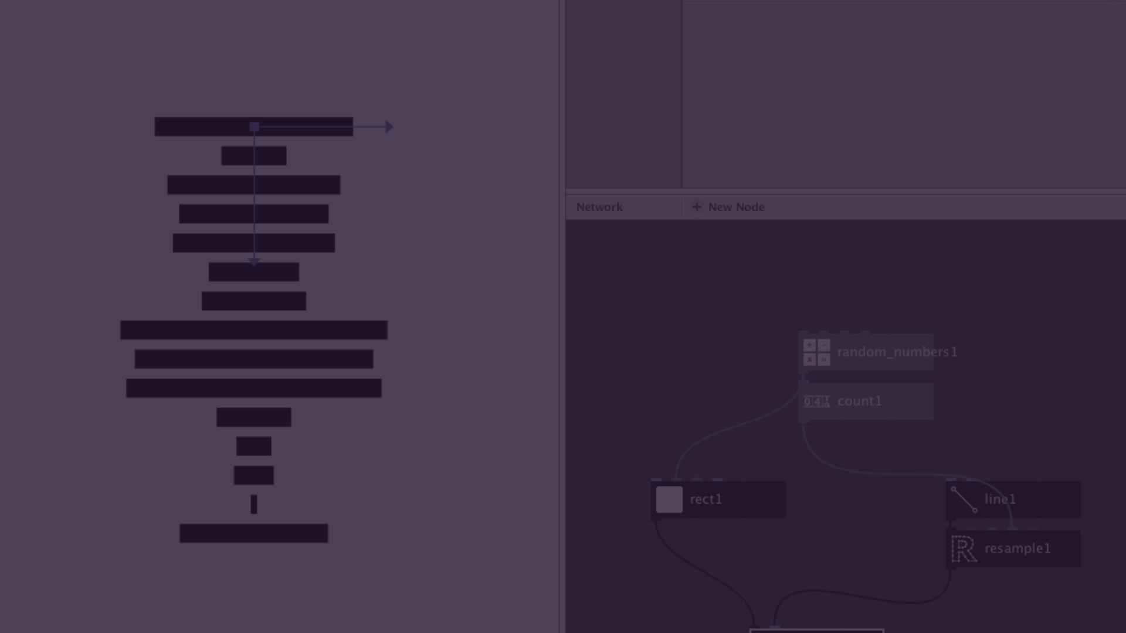
Data Cleaning and Processing
Necessity of Clean Data
Cleaning Techniques
Data cleaning is a necessary step in the data analysis process. It involves ensuring that the dataset is correct, consistent, and usable, which may require removing inaccuracies or processing the data into a format better suited for analysis.
Common techniques include removing duplicate records, handling missing values, and correcting mismatches or outliers. This improves the accuracy of the analysis, leading to more trustworthy research outcomes.

Slide 15
Applications in Social Sciences
Sociology
Political Science
Anthropology
In sociology, web scraping can unearth patterns and relationships within communities by analyzing social networks, forums, and online interactions, providing a deeper understanding of social structures.
Political scientists use web scraping to monitor policy impacts, public opinion, and political activities across various platforms, making it easier to measure the pulse of the electorate and the dynamics of political discourse.
Scraped web data aids anthropologists by providing access to a multitude of cultural artifacts and expressions found online, from blogs to multimedia content, which may otherwise be difficult to catalogue and study.

Slide 16

Challenges and Limitations
1
IP Blocks
One common challenge in web scraping is IP blocking by websites, often triggered by making too many requests in a short timeframe, which can hinder data collection efforts.
2
Anti-scraping Technologies
Websites may employ a range of anti-scraping measures, from CAPTCHAs to complex tracking systems that can detect and block scraping bots.
3
Data Accuracy
Ensuring the accuracy and validity of the scraped data is a persistent concern, requiring rigorous checks and validations. Misinterpretation of data structures can lead to flawed research findings.

Slide 17
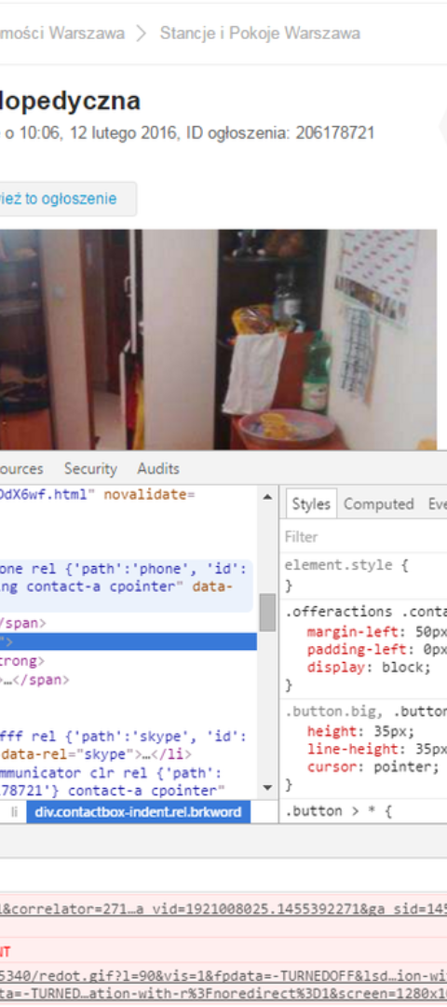
Further Resources
Books and Articles
Dive deeper into the subject with a curated list of books and scholarly articles that offer in-depth knowledge and techniques in web scraping and data analysis.
Online Courses
Online courses provide step-by-step tutorials and hands-on projects that can accelerate the learning curve for both beginners and experienced scrapers.
Community Forums
Joining community forums and engaging with peers can provide collaborative opportunities, help solve challenges, and stay updated with the latest trends in web scraping.

Slide 18
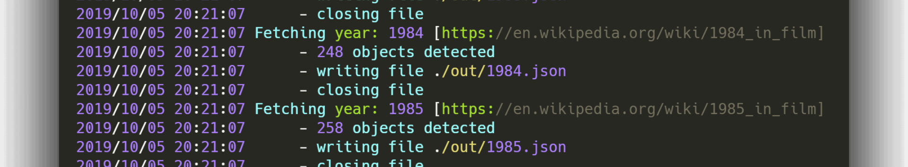
Conclusion
As we wrap up our Introduction to Web Scraping for Social Sciences, take a moment to reflect on the wealth of information available through web data. We've explored the what, why, and how, discussing everything from technicalities to ethical dilemmas. Your journey into the realm of web scraping, enriched with new insights and skills, is just beginning.
Remember, web scraping is not just a method; it's an empowering tool for social scientists. It allows us to capture a snapshot of human interaction on a scale like never before. With these skills, you stand at the precipice of discovery, ready to unveil the stories hidden within the data. Go forth and scrape responsibly, as you turn the digital threads of the web into the fabric of understanding that shapes social science research.

